Slide 1

Loan approval Analysis
BY ANURAG PAWAR

Slide 2
Scenario
Gold Atlantis, a credit providing firm, is observing a rise in the number of defaulters.
Now, the firm is only interested in those consumers who have lower probability of becoming defaulter.
When Gold Atlantis receives a credit application, it approves or disapproves the application based on the applicant’s profile.

Slide 3
The Problem Statement
If the applicant is likely to repay the loan, then disapproving the loan may result in a loss of business to the firm.
If the applicant is not likely to repay the loan, that is if the applicant is a defaulter, then approving the loan may lead to a financial loss to the firm.
My job as an Analyst is to analyze the patterns present in the data that will ensure that the applicants are capable of repaying the credit.

Slide 4
Data Provided About Applicant
ID of Loan
Target Variable
Contract Type
Gender
Car
House
Count of Children
Total Income Amount
Credit Amount
Goods Price Amount
Name Type Suite
Education Type

Slide 5
Data Provided about Applicant
Family Status
Days Employed
Mobile
Work Phone
Home Phone
Mobile reachable
Email
Occupation Type
Income Type
Count of Family Members
Application Day
Documents Submitted

Slide 6
Univariate Analysis
The primary analysis of all the attributes revealed certain information:
There are some columns containing null values
Some columns are containing values which are very extreme in comparison to the trend shown by the overall column
We had to remove these rows in order to have a fair analysis, and these rows will have to be analysed separately as special cases.

Slide 7
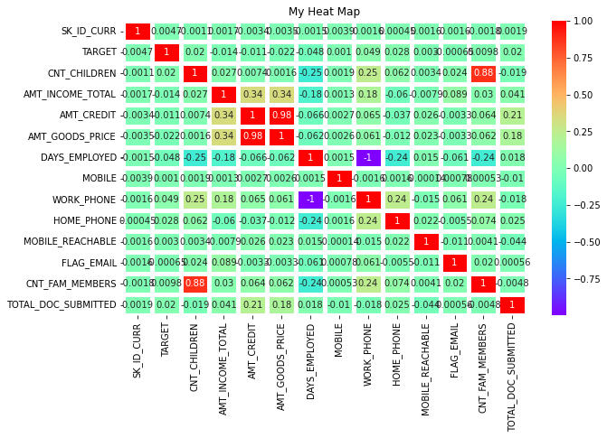
Analysing Correlation of all Attributes
From This Heatmap we can conclude the following things
There is a direct correlation between goods price amount and credit amount.
There is a direct correlation between count of children and count of family members.

Slide 8
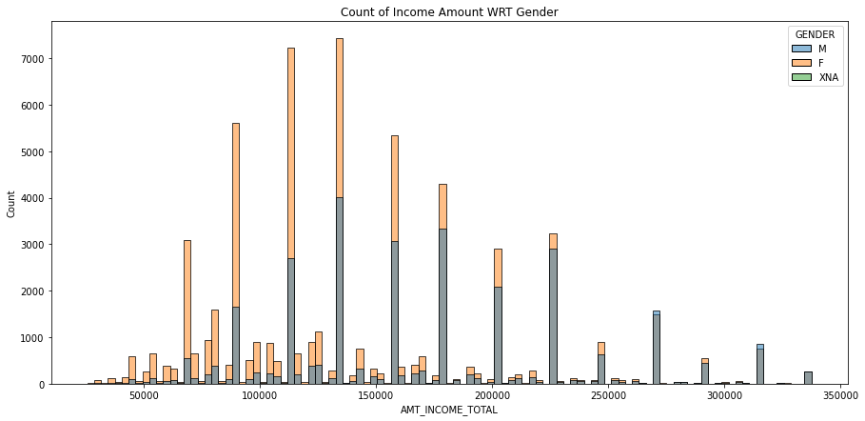
Analysing income with respect to gender
Here we can see that for the income categories lower than 250000 there are more female applicants but for income categories more than 250000 the number male applicants is more than that of female applicants.

Slide 9
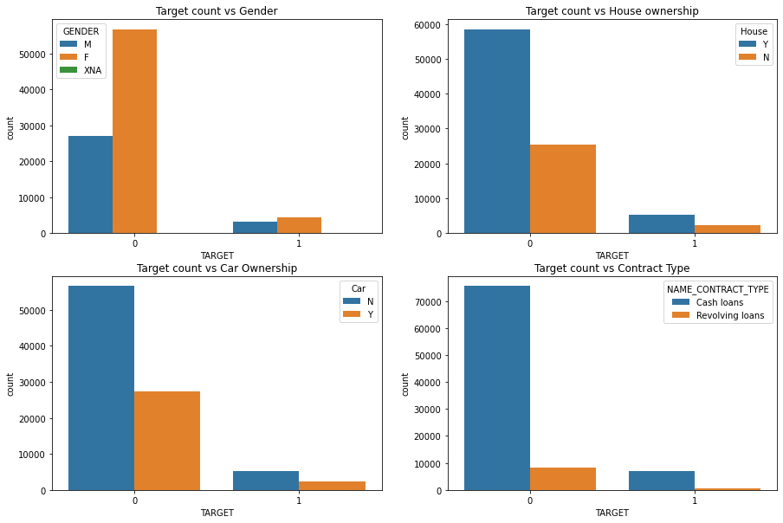
Target dashboard
The following inferences can be made from this Dashboard.
The proportion of male applicants in defaulters is more than that of the female applicants.
Around 2/3rd of the defaulted applicants own a house.
Around 2/3rd of the defaulted applicants don't own a car.
The applicants who have defaulted consist majority of cash loan applicants.

Slide 10
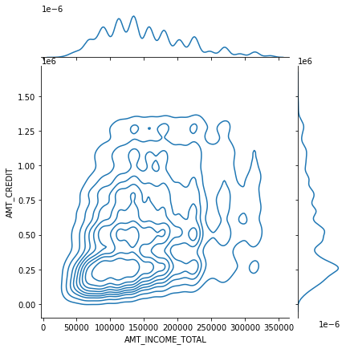
Analysing Credit amount vs Income amount
Here we can see the applicants are densely populated in the income amount range of 70000-120000 and the credit range of 120000-300000

Slide 11
Risk analysis score (ras)
To determine which applicants should be shortlisted to approve their loan we will create a new attribute called Risk Analysis Score (RAS).
Major Factors
Income Amount
House Ownership
Target Score
Count of children
Credit amount

Slide 12
Risk analysis score (RAS)
Minor Factors
Mobile
Work Phone
Home Phone
Email
Documents Submitted
Car
Mobile Reachable

Slide 13
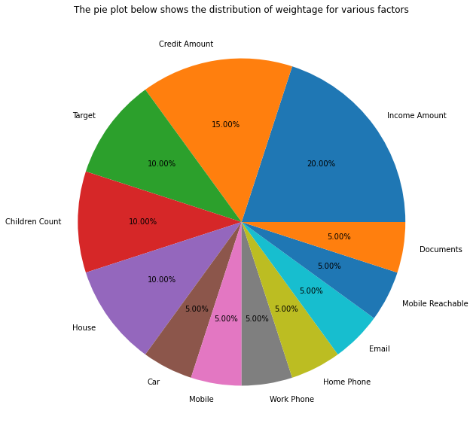
Weightage for all the factors

Slide 14
Deriving the formula for ras
For factors like Mobile, Work Phone, Home Phone, Mobile Reachable, Email, Car 5 points will get added to the RAS.
For factors such as House and Target score 10 points will get added to the RAS.
For documents submitted the applicant will get 1-5 point with 1 point for 0 documents or 5 points for 4 documents submitted.
For count of children the applicant will get 2-10 points with 2 for 4 children and 10 for no children.
For income amount, 0-20 points will be added to the RAS with 20 being for maximum income.
Similarly for credit amount 0-15 points will be added to the RAS with 15 being for minimum credit amount.

Slide 15
Identifying the approved loans
From the RAS score that we have calculated for each applicant, it has become very easy to identify the loan application that would be less risky for the bank to approve.
The greater the RAS threshold the lesser number of applications gets approved.
For now we are considering the Threshold RAS as 63 which also happens to be the median value.

Slide 16
Pros and Cons
There are some pros and cons for the RAS method:
Pros
Due to this method the method the bank can have the control over the number of loans to be approved just by manipulating the threshold RAS.
The RAS that we are deriving consist of various different factors in a right balance based on the relevance of each factor.
Cons
For change in the main data, some minor tweaks will have to be done in the RAS formula.

Slide 17
prescription
While analysing the data I came across some null values in some columns, and therefore those applications were taken out of consideration. The bank employees are advised to take a follow-up and get the missing information.
I also came across some values that were very extreme in nature, and therefore we had to take those application out of consideration for the purpose of fair analysis. The bank is advised to treat those applications as special cases and approve them separately.

Slide 18
Thank you

